Slide 1
Class 11- Understanding Sorting
Bubble Sort and Insertion Sort

Slide 2
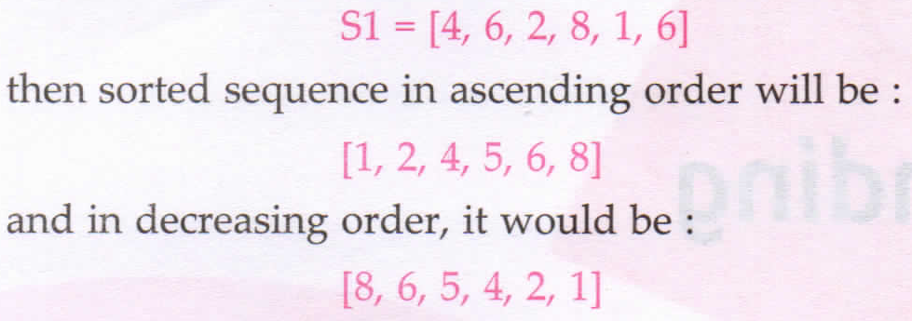
Introduction to Sorting
Sorting means – from a pile of mixed objects, picking and replacing identical objects into separate groups.
But in computer terms, sorting means arranging these elements in a specific order(increasing order or decreasing order).
For example:

Slide 3
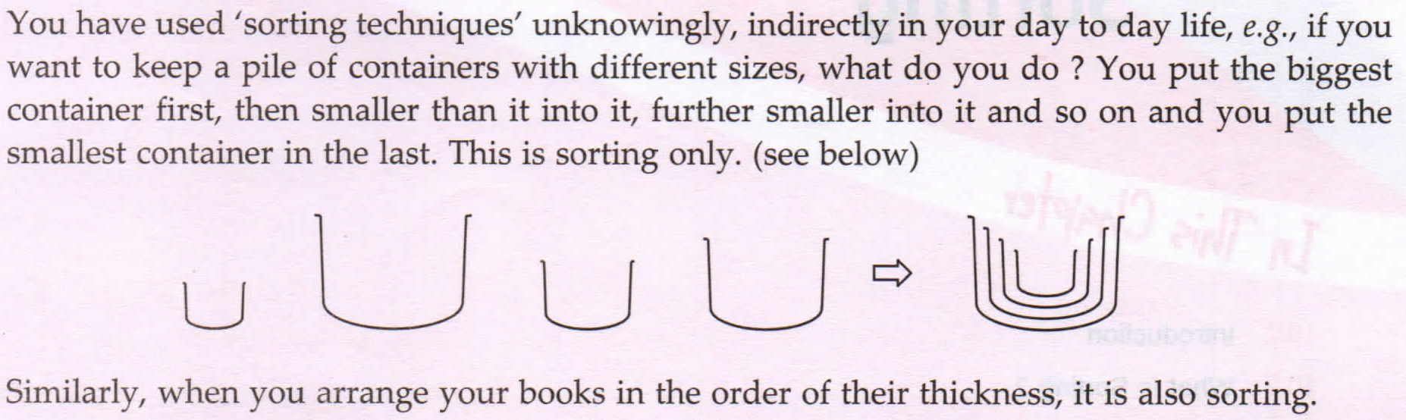

Slide 4
Bubble Sort [Worst Case: O(n^2) Best Time Complexity :O(n^2)] ]
The basic idea of bubble sort is to compare two adjoining values and exchange them if they are not in proper order.
For instance , unsorted array is being sorted in ascending order using bubble sort.
In every pass, the heaviest element settles as its appropriate position in the bottom.

Slide 5
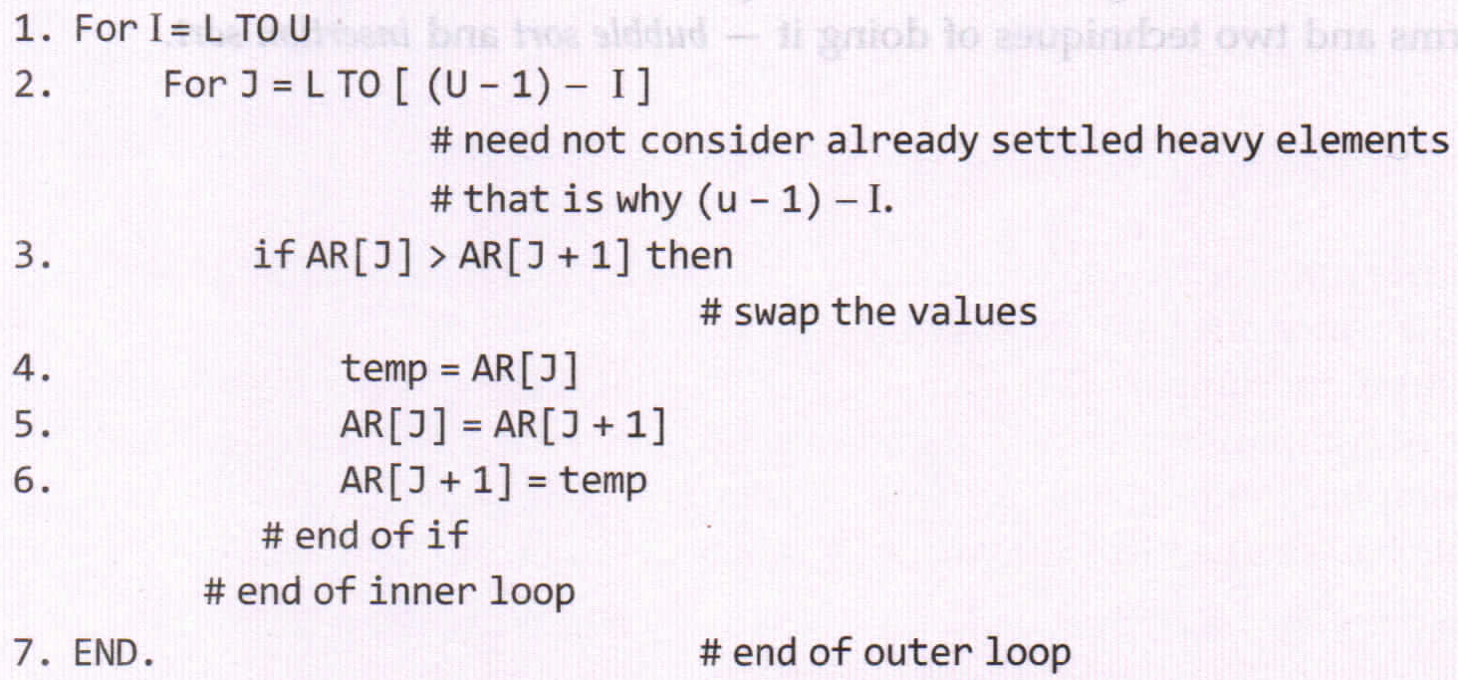
Algorithm… .. .

Slide 6
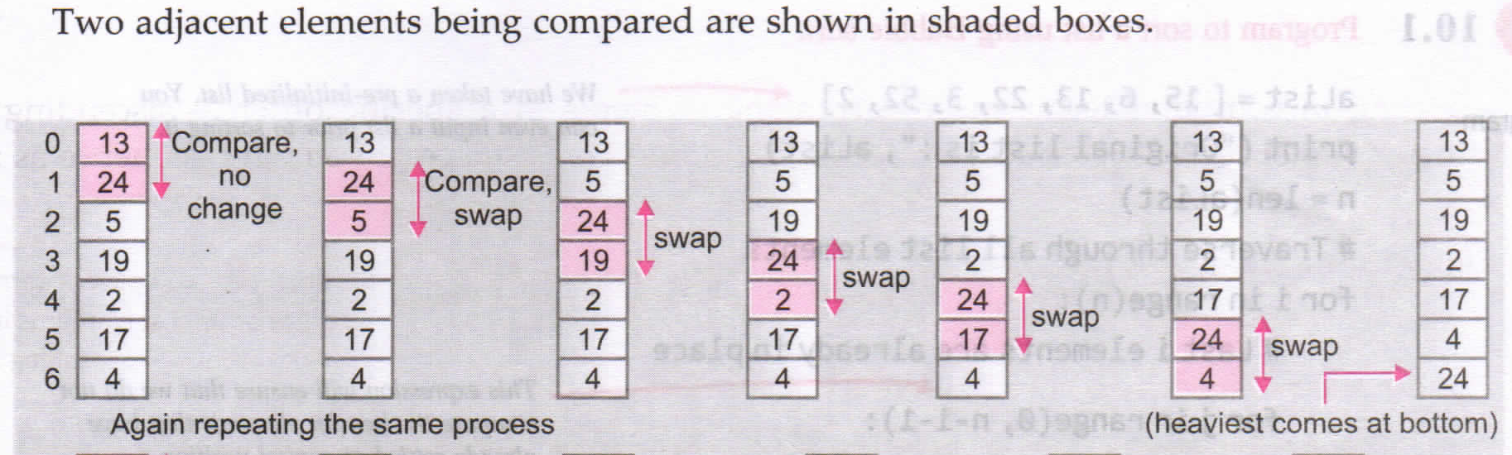

Slide 7
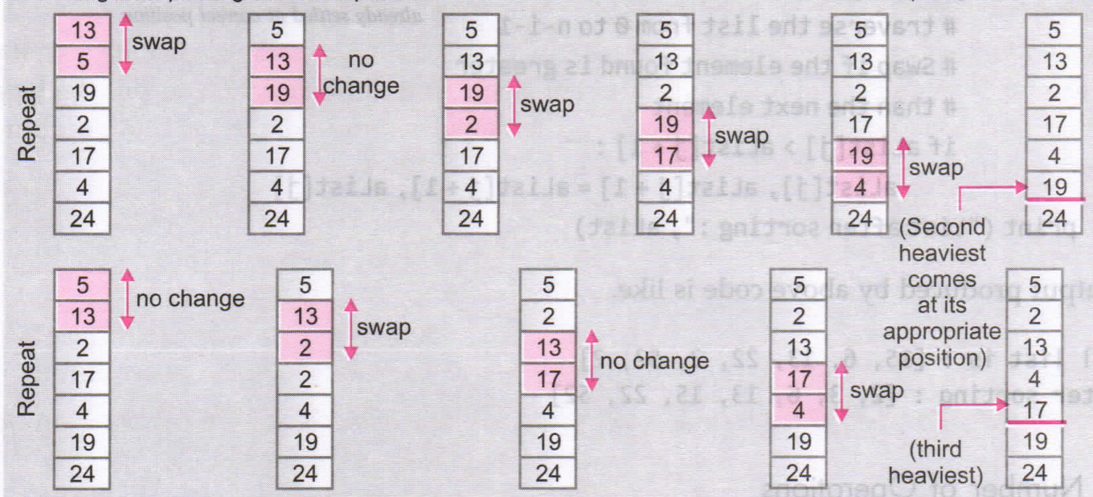

Slide 8
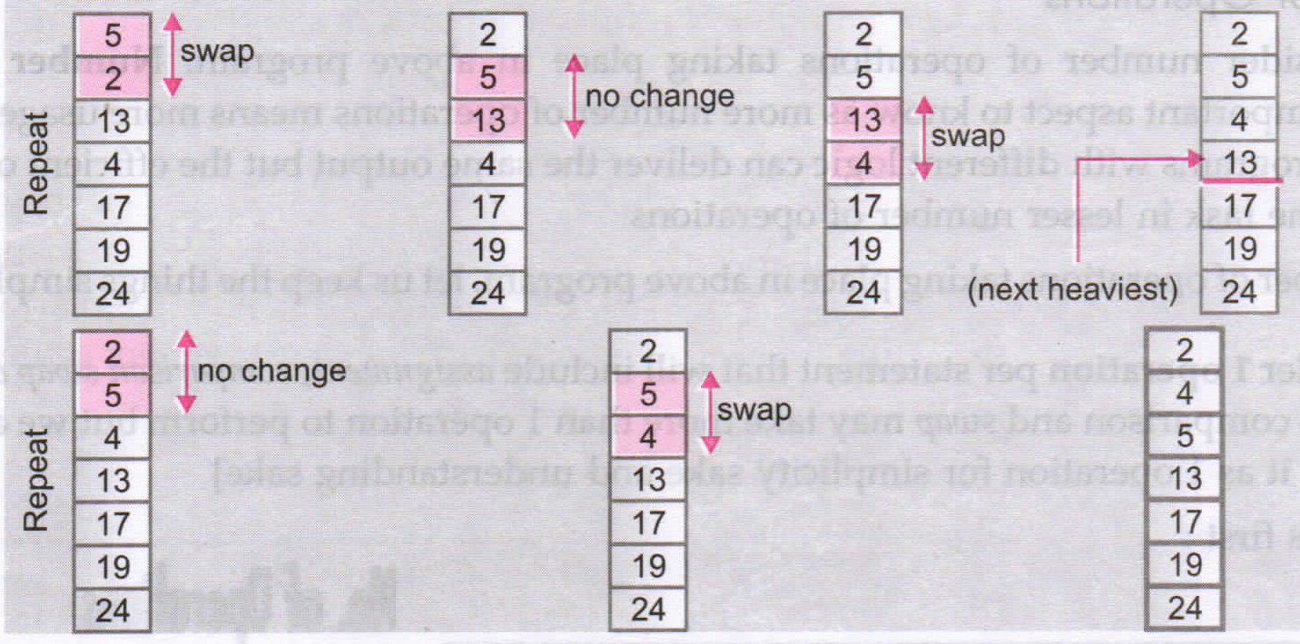

Slide 9
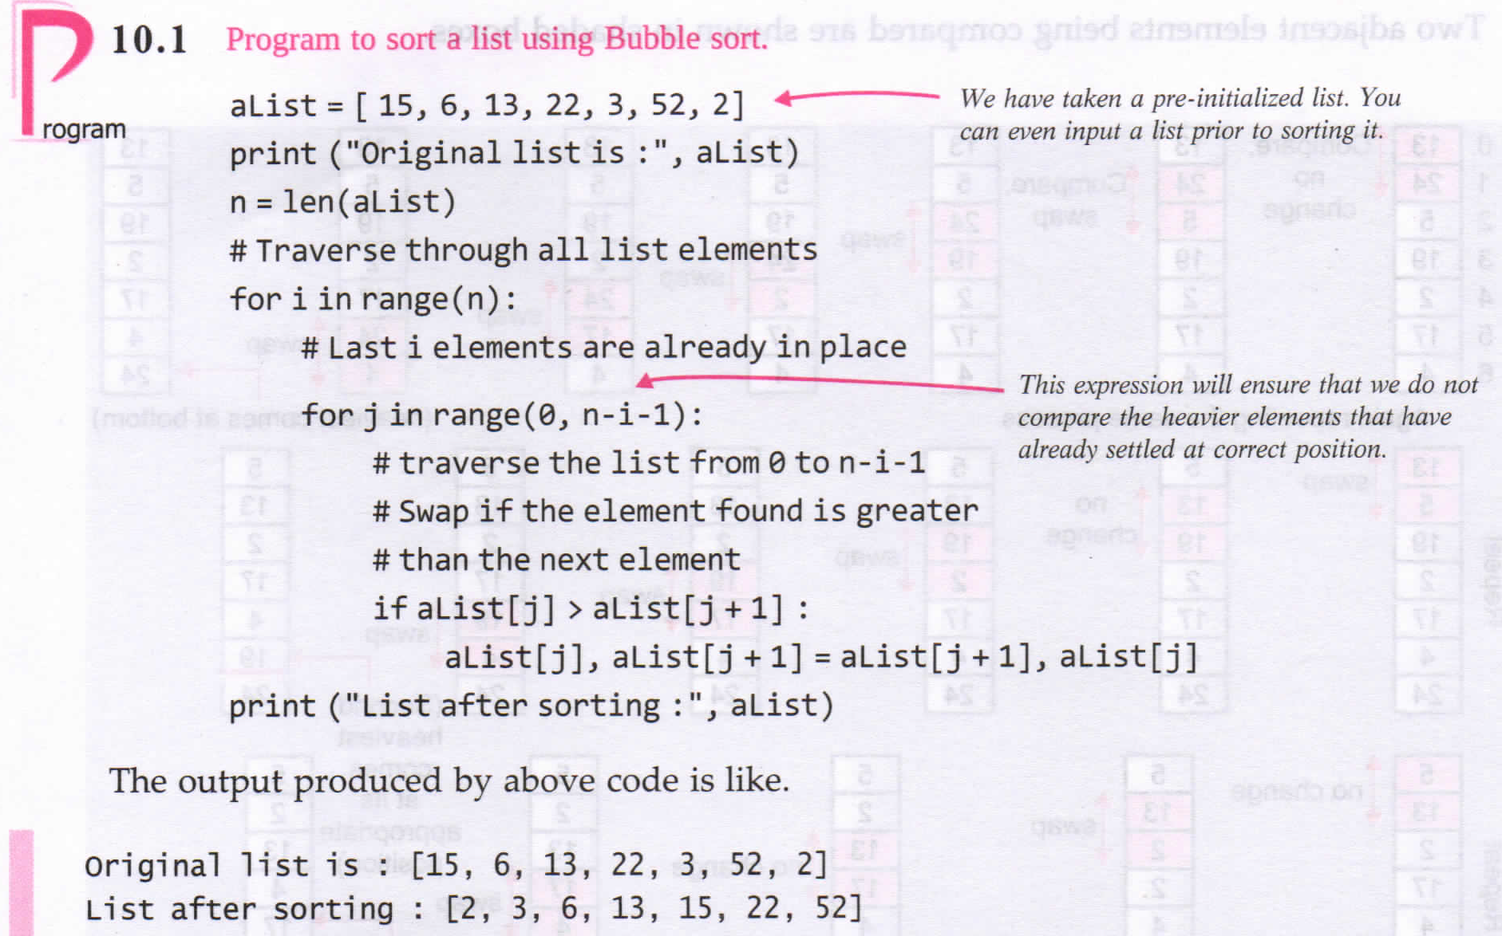

Slide 10
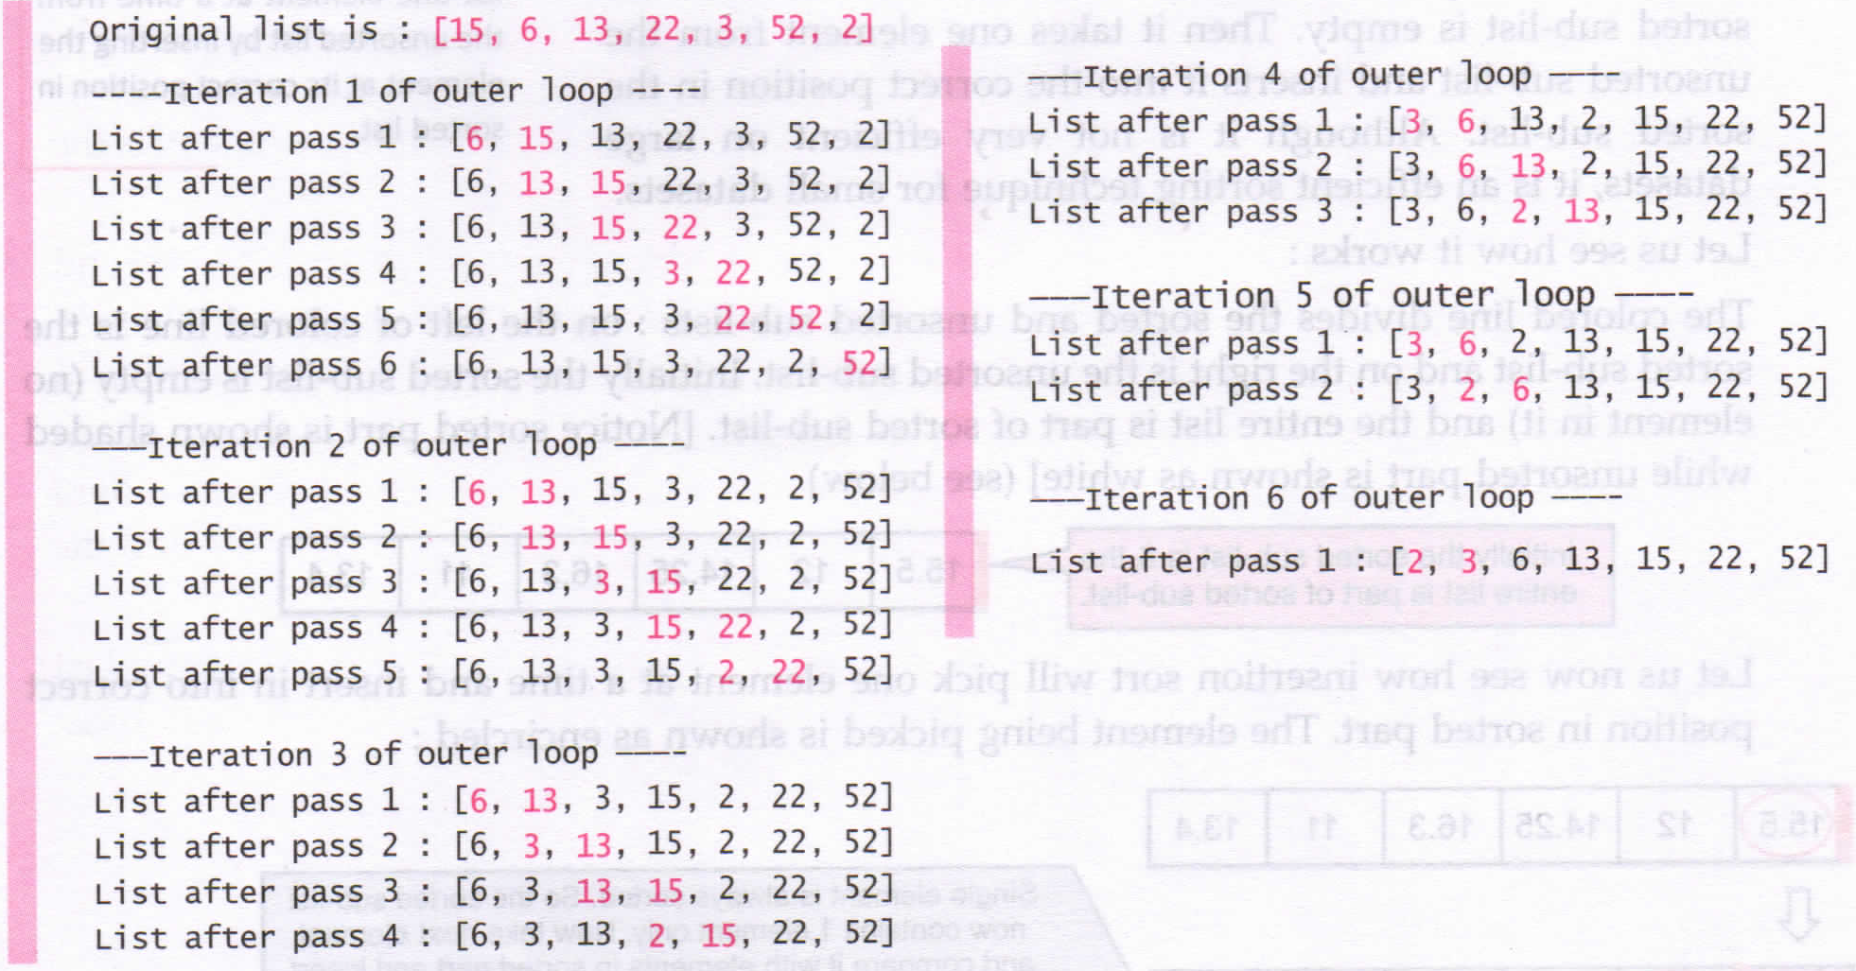

Slide 11
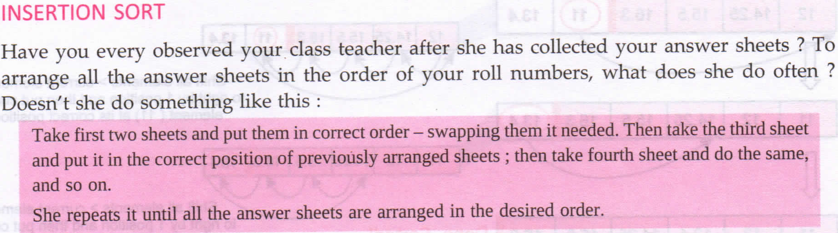
Insertion Sort [Worst Case: O(n^2) Best Time Complexity :O(n)] is a sorting algorithm that builds a sorted list one element at a time from the unsorted list by inserting the element at it’s correct position in sorted list.

Slide 12
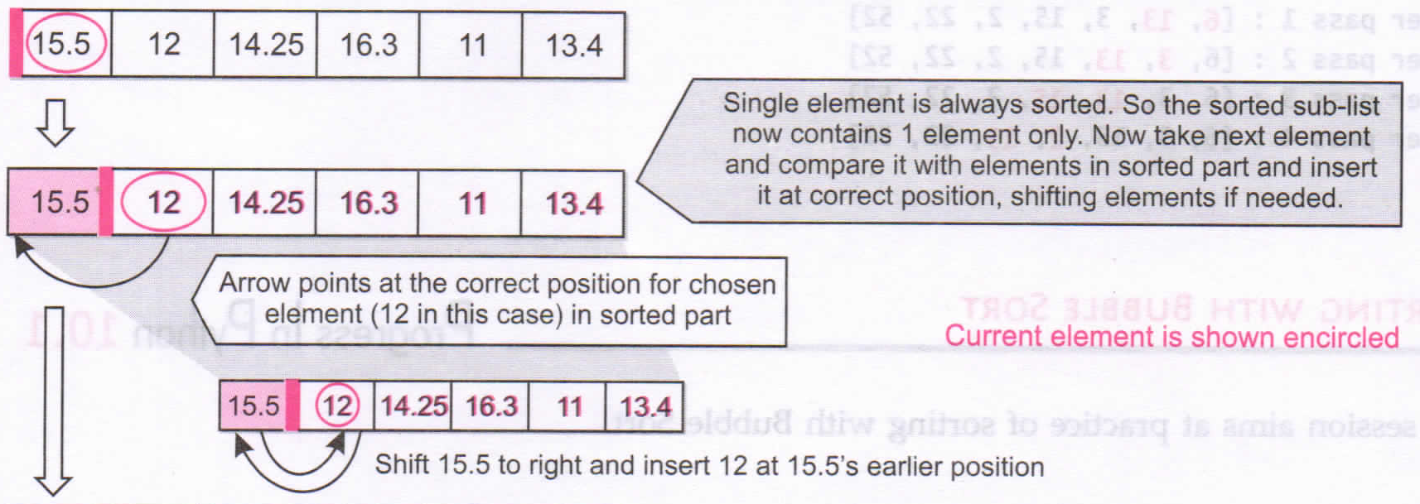

Slide 13
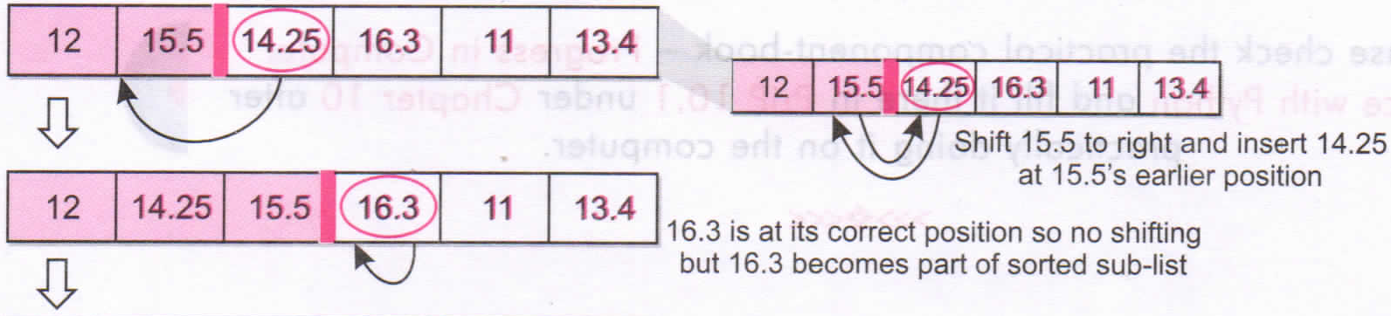

Slide 14
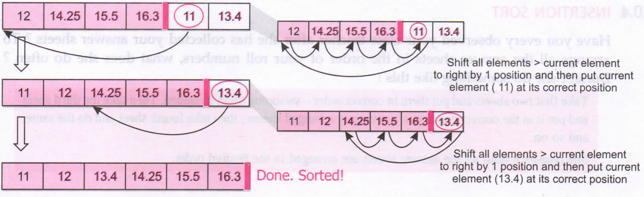
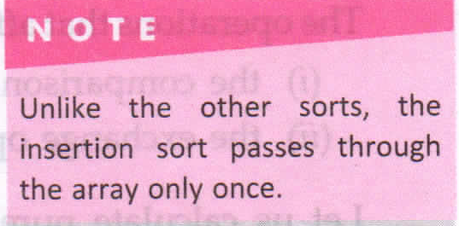

Slide 15
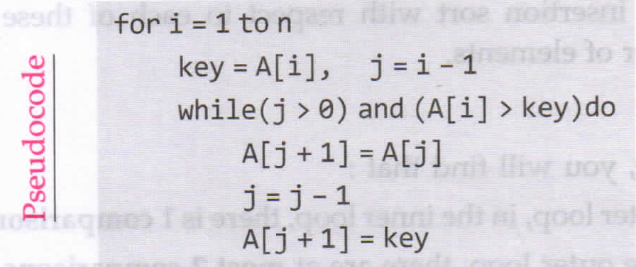
Algorithm… .. .

Slide 16
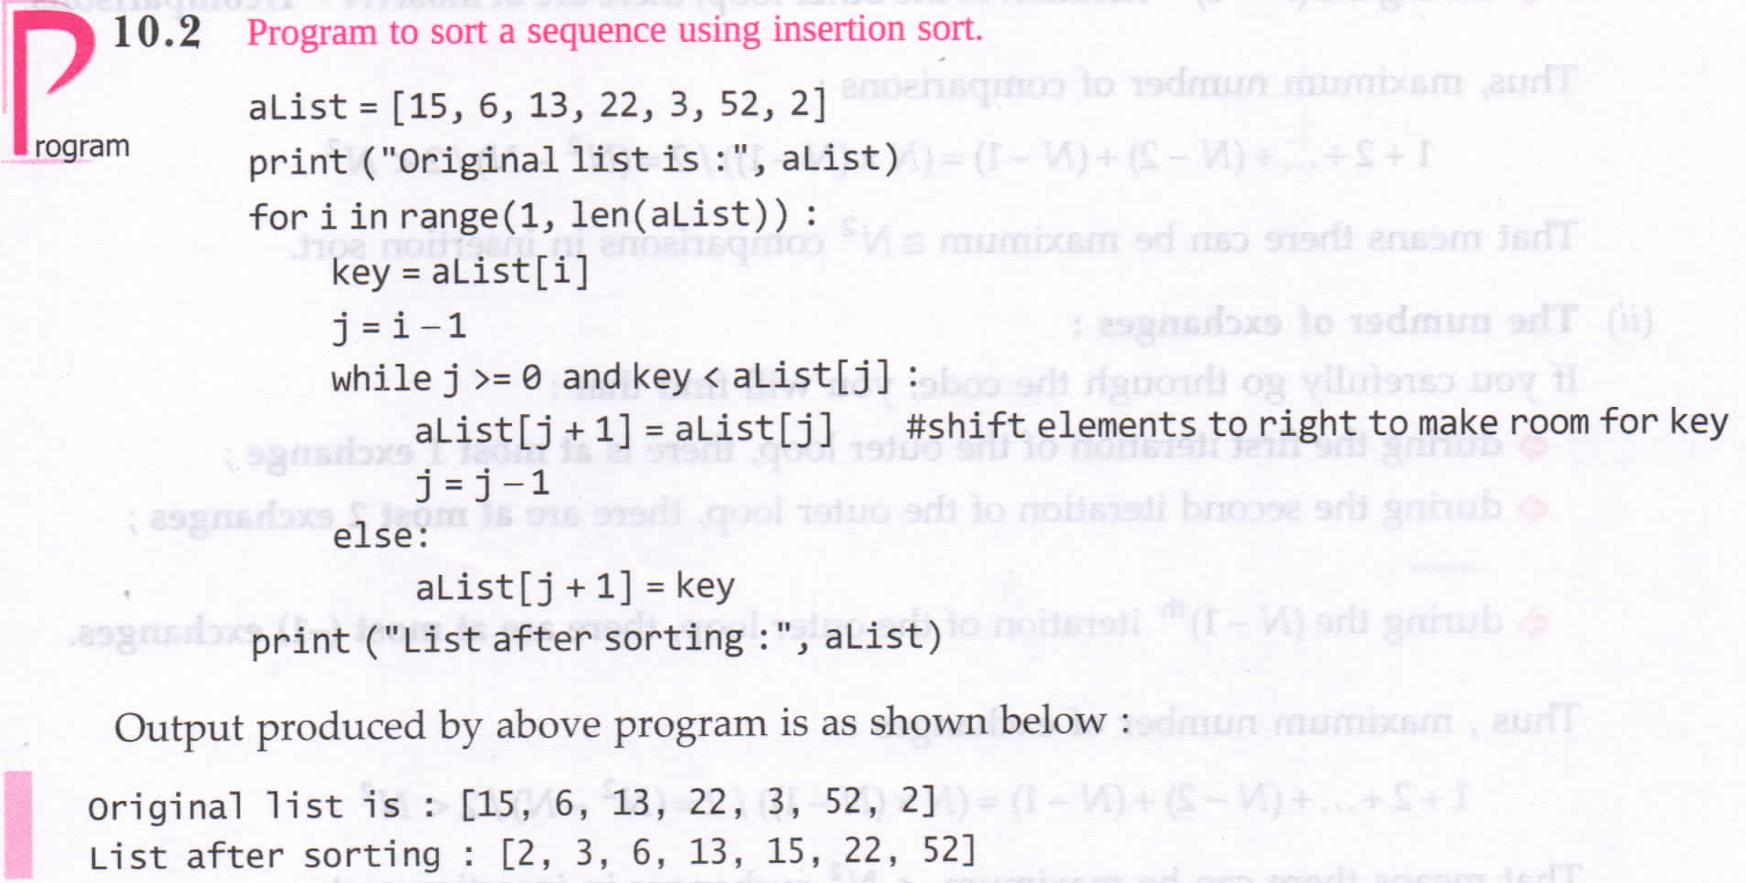

Slide 17
